Slide 1

Testing scientific code Because you’re worth it
Pietro Berkes, NAGRA Insight

Slide 2

You as the Master of Research
You start a new project and identify a number of possible leads.
You quickly develop a prototype of the most promising ones; once a prototype is finished, you can confidently decide whether that lead is a dead end, or worth continuing.
Once you find an idea that is worth spending energy on, you take the prototype and easily re-organize and optimize it so that it scales up to the full size of your problem.
As expected, the scaled up experiment delivers good results and your next paper is under way.

Slide 3

Reaching Enlightenment
How do we get to the blessed state of confidence and efficiency?
Being a Python expert is not sufficient, good programming practices make a big difference
We can learn a lot from the development methods developed for commercial and open source software
lambda
Notes:
Me: Java during studies, in neuroscience everybody assumed I could use Matlab, luckily I had some Python background

Slide 4
Outline
The agile programming cycle
Testing scientific code basics
Testing patterns for scientific code

Slide 5
Before we start
Clone the repository with the material for this class: https://github.com/ASPP/testing_debugging_profiling.git

Slide 6
The agile programming cycle

Slide 7
Warm-up project
Write a function that finds the position of local maxima in a list of numbers

Slide 8
Warm-up project
Write a function that finds the position of local maxima in a list of numbers
Check your solution with these inputs:
Input: [1, 4, -5, 0, 2, 1] Expected result: [1, 4]
Input: [-1, -1, 0, -1] Expected result: [2]
Input: [4, 2, 1, 3, 1, 5] Expected result: [0, 3, 5]
Input: [1, 2, 2, 1] Expected result: [1] (or [2], or [1, 2])

Slide 9
The agile development cycle
Write tests to check that feature works
Write simplest code that makes tests pass
Run tests and debug until all tests pass
Refactor and optimize only if necessary
Pick your next feature
Notes:
As opposed to waterfall model
Reminder
1) describe cycle
2) short development cycles: granularity of chosen feature is important
3) for all of these steps there are python tools to help you; there’s no tool yet for writing the code, unfortunately

Slide 10
Python tools for agile development
Write tests to check that feature works
Write simplest code that makes tests pass
Run tests and debug until all tests pass
Refactor and optimize only if necessary
Pick your next feature
py.test
pdb
timeit
cProfile
line_profiler
Notes:
3) for all of these steps there are python tools to help you; there’s no tool yet for writing the code, unfortunately

Slide 11
Testing scientific code

Slide 12
The agile development cycle
Write tests to check that feature works
Write simplest code that makes tests pass
Run tests and debug until all tests pass
Refactor and optimize only if necessary
Pick your next feature
py.test
pdb
timeit
cProfile
line_profiler

Slide 13
Why write tests?
Confidence:
Write the code once and use it confidently everywhere else: avoid the negative result effect!
Correctness is main requirement for scientific code
You must have a strategy to ensure correctness

Slide 14
Effect of software bugs in science
frequency
bug severity
oops, wrong labels!
need to send errata corrige
end of career
Notes:
Made up plot, not backed by any data; and no error bars!
This slide is supposed to scare you into listening to the rest
didn’t properly shuffle my data for the control, a couple of results are not statistically significant any more… errata

Slide 15
The unfortunate story of Geoffrey Chang
Science, Dec 2006: 5 high-profile retractions (3x Science, PNAS, J. Mol. Biol.) because ”an in-house data reduction program introduced a change in sign for anomalous differences”
Notes:
When you get a crappy result, you triple check your code for bugs. If the results come out just the way you want them to, how much effort are you going to put into double-checking?
For two errors reported and retraced, many more undetected or not reported.

Slide 16
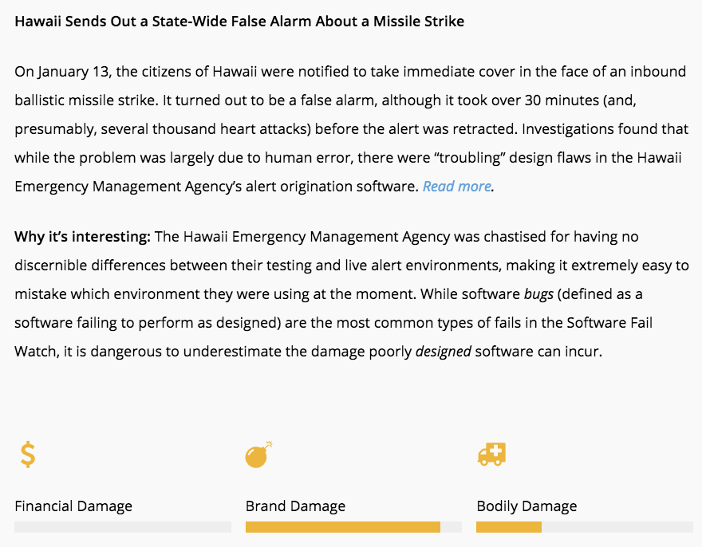
Meanwhile, in Hawaii…
Professor Falken, you didn’t write any tests, did you?
January 13, 2018
https://www.tricentis.com/blog/2018/04/12/software-fail-watch-q1-2018/

Slide 17
Testing basics

Slide 18
Testing frameworks for Python
unittest
nosetests
py.test

Slide 19
Test suites in Python with py.test
Writing tests with py.test is simple:
Each test is a function whose name begins by “test_”
Each test tests one feature in your code, and checks that it behaves correctly using “assertions”. An exception is raised if it does not work as expected.

Slide 20
Testing with Python
Tests are automated:
Write test suite in parallel with your code
External software runs the tests and provides reports and statistics
============================ test session starts ================================
platform darwin -- Python 3.5.2, pytest-2.9.2, py-1.4.31, pluggy-0.3.1 -- /Users/pberkes/miniconda3/envs/gnode/bin/python
cachedir: .cache
rootdir: /Users/pberkes/o/pyschool/testing_debugging_profiling/hands_on/pyanno_voting_solution, inifile:
collected 4 items
pyanno/tests/test_voting.py::test_labels_count PASSED
pyanno/tests/test_voting.py::test_majority_vote PASSED
pyanno/tests/test_voting.py::test_majority_vote_empty_item PASSED
pyanno/tests/test_voting.py::test_labels_frequency PASSED
========================= 4 passed in 0.23 seconds ==============================
Notes:
everybody “tests” his software, little toy problems, or just run it and use it for a while and see than nothing breaks

Slide 21
Hands-on!
Go to hands_on/pyanno_voting
Execute the tests: py.test
Score for each item
2 | 3 | -1
-1 | 5 | 4
1 | 4 | 3
-1 | -1 | 3
A score of MISSING_VALUE (-1) means the annotator did not score that item
Annotators
Notes:
PyAnno: describe context a little bit; how are annotations represented
Show directory structure
Open file, comment on content
Show next slide: all the ways to execute a test

Slide 22
How to run tests
1) Discover all tests in all subdirectories py.test -v
2) Execute all tests in one module py.test -v pyanno/tests/test_voting.py
3) Execute one single test py.test –v test_voting.py::test_majority_vote

Slide 23
Possibly your first test file
Create a new file, test_something.py:
Save it, and execute the tests
def test_arithmetic(): assert 1 == 1 assert 2 * 3 == 6 def test_len_list(): lst = ['a', 'b', 'c'] assert len(lst) == 3
Notes:
Import unittest
Define a test unit as a subclass of TestCase
Define a series of methods beginning with ‘test_’ that test some aspect of the code
When unittest.main() is called, the method automatically finds the tests and executes them one by one giving back a report

Slide 24
Assertions
assert statements check that some condition is met, and raise an exception otherwise
Check that statement is true/false: assert 'Hi'.islower() => fail assert not 'Hi'.islower() => pass
Check that two objects are equal: assert 2 + 1 == 3 => pass assert [2] + [1] == [2, 1] => pass assert 'a' + 'b' != 'ab' => fail
assert can be used to compare all sorts of objects, and py.test will take care of producing an approriate error message

Slide 25
Hands-on!
Add a new test to test_something.py: test that 1+2 is 3
Execute the tests

Slide 26
Hands-on!
Add a new test to test_something.py: test that 1+2 is 3
Execute the tests
Now test that 1.1 + 2.2 is 3.3

Slide 27
Floating point equality
Real numbers are represented approximately as “floating point” numbers. When developing numerical code, we have to allow for approximation errors.
Check that two numbers are approximately equal: from math import isclose def test_floating_point_math(): assert isclose(1.1 + 2.2, 3.3) => pass
abs_tol controls the absolute tolerance: assert isclose(1.121, 1.2, abs_tol=0.1) => pass assert isclose(1.121, 1.2, abs_tol=0.01) => fail
rel_tol controls the relative tolerance: assert isclose(120.1, 121.4, rel_tol=0.1) => pass assert isclose(120.4, 121.4, rel_tol=0.01) => fail
Notes:
If you’re working with floating point numbers two number are rarely exactly the same

Slide 28
Hands-on!
One more equality test: check that the sum of these two NumPy arrays: x = numpy.array([1, 1]) y = numpy.array([2, 2]) is equal to z = numpy.array([3, 3])

Slide 29
Testing with NumPy arrays
def test_numpy_equality(): x = numpy.array([1, 1]) y = numpy.array([2, 2]) z = numpy.array([3, 3]) assert x + y == z
__________________________________ test_numpy_equality __________________________________
def test_numpy_equality():
x = numpy.array([1, 1])
y = numpy.array([2, 2])
z = numpy.array([3, 3])
> assert x + y == z
E ValueError: The truth value of an array with more than one element is ambiguous. Use a.any() or a.all()
code.py:47: ValueError
Notes:
The intention was to test for equality element-by-element

Slide 30
Testing with numpy arrays
numpy.testing defines appropriate functions: assert_array_equal(x, y) assert_array_almost_equal(x, y, decimal=6)
If you need to check more complex conditions:
numpy.all(x): returns True if all elements of x are true numpy.any(x): returns True is any of the elements of x is true numpy.allclose(x, y, rtol=1e-05, atol=1e-08): returns True if two arrays are element-wise equal within a tolerance
combine with logical_and, logical_or, logical_not: # test that all elements of x are between 0 and 1 assert all(logical_and(x > 0.0, x < 1.0))
Notes:
The right way to do this is using …
If you need to check more complex conditions
allclose:
The tolerance values are positive, typically very small numbers. The
relative difference (`rtol` * abs(`b`)) and the absolute difference
`atol` are added together to compare against the absolute difference
between `a` and `b`.

Slide 31
Hands-on!
In voting , there is an empty function, labels_frequency. Write a test for it, then an implementation.
def labels_frequency(annotations, nclasses): """Compute the total frequency of labels in observed annotations. Example: >>> labels_frequency([[1, 1, 2], [-1, 1, 2]], 4) array([ 0. , 0.6, 0.4, 0. ]) Arguments --------- annotations : array-like object, shape = (n_items, n_annotators) annotations[i,j] is the annotation made by annotator j on item i nclasses : int Number of label classes in `annotations` Returns ------- freq : ndarray, shape = (n_classes, ) freq[k] is the frequency of elements of class k in `annotations`, i.e. their count over the number of total of observed (non-missing) elements """

Slide 32
Testing error control
Check that an exception is raised: from py.test import raises def test_raises(): with raises(SomeException): do_something() do_something_else()
For example: with raises(ValueError): int('XYZ’) passes, because int('XYZ’) ValueError: invalid literal for int() with base 10: 'XYZ'
Notes:
Finally

Slide 33
Testing error control
Use the most specific exception class, or the test may pass because of collateral damage: # Test that file "None" cannot be opened. with raises(IOError): open(None, 'r') as expected, but with raises(Exception): open(None, 'r’)
=> fail
=> pass

Slide 34
Hands-on!
Have a look at the docstring of labels_count : It says the function raises an error if there are no valid observations, but that’s not tested!
Add a test checking that the function raises an error if we pass an empty list of annotations

Slide 35
Testing patterns

Slide 36
What a good test looks like
What does a good test looks like? What should I test?
Good:
Short and quick to execute
Easy to read
Exercise one thing
Bad:
Relies on data files
Messes with “real-life” files, servers, databases

Slide 37
Basic structure of test
A good test is divided in three parts:
Given: Put your system in the right state for testing
Create data, initialize parameters, define constants…
When: Execute the feature that you are testing
Typically one or two lines of code
Then: Compare outcomes with the expected ones
Define the expected result of the test
Set of assertions that check that the new state of your system matches your expectations

Slide 38
Test simple but general cases
Start with simple, general case
Take a realistic scenario for your code, try to reduce it to a simple example
Tests for ‘lower’ method of strings
def test_lower(): # Given string = 'HeLlO wOrld' expected = 'hello world' # When output = string.lower() # Then assert output == expected

Slide 39
Test special cases and boundary conditions
Code often breaks in corner cases: empty lists, None, NaN, 0.0, lists with repeated elements, non-existing file, …
This often involves making design decision: respond to corner case with special behavior, or raise meaningful exception?
def test_lower_empty_string(): # Given string = '' expected = '' # When output = string.lower() # Then assert output == expected
Other good corner cases for string.lower():
‘do-nothing case’: string = 'hi'
symbols: string = '123 (!'
Notes:
First of all, you should start with testing your code with
explain typical test structure
show general case: two words, upper case chars randomly dispersed
special cases
SHOW THIS (cut & paste code)

Slide 40
Common testing pattern
Often these cases are collected in a single test:
def test_lower(): # Given # Each test case is a tuple of (input, expected_result) test_cases = [('HeLlO wOrld', 'hello world'), ('hi', 'hi'), ('123 ([?', '123 ([?'), ('', '')] for string, expected in test_cases: # When output = string.lower() # Then assert output == expected

Slide 41
Hands-on!
Go back to the tests you wrote so far in test_something.py and test_voting.py, and reorganize the tests to follow the Given / When / Then pattern
5 minutes

Slide 42
Numerical fuzzing
Use deterministic test cases when possible
In most numerical algorithm, this will cover only over-simplified situations; in some, it is impossible
Fuzz testing: generate random input
Outside scientific programming it is mostly used to stress-test error handling, memory leaks, safety
For numerical algorithm, it is often used to make sure one covers general, realistic cases
The input may be random, but you still need to know what to expect
Make failures reproducible by saving or printing the random seed
Notes:
In textbooks about testing you will read that tests should always be deterministic
For example, if you want to test a function that computes the Fourier components of a signal: one can define simple deterministic cases (single sine wave), but it’s not general enough
GOOD EXAMPLE: better is random mixtures of sine waves, colored noise, signal with stationary statistics => compute the eigenvalues of the covariance matrix

Slide 43
Numerical fuzzing example
def test_mean_deterministic():
x = numpy.array([-2.0, 2.0, 6.0])
expected = 2.0
assert isclose(numpy.mean(x), expected)
def test_mean_fuzzing():
rand_state = numpy.random.RandomState(1333)
N, D = 100000, 5
# Goal means: [0.1 , 0.45, 0.8 , 1.15, 1.5]
expected = numpy.linspace(0.1, 1.5, D)
# Generate random, D-dimensional data with the desired mean
x = rand_state.randn(N, D) + expected
means = numpy.mean(x, axis=0)
numpy.testing.assert_allclose(means, expected, rtol=1e-2)

Slide 44
Hands-on!
Write two tests for the function numpy.var : 1) First, a deterministic test 2) Then, a numerical fuzzing test

Slide 45
Numerical fuzzing – solution
def test_var_deterministic(): x = numpy.array([-2.0, 2.0]) expected = 4.0 assert isclose(numpy.var(x), expected) def test_var_fuzzing(): rand_state = numpy.random.RandomState(8393) N, D = 100000, 5 # Goal variances: [0.1 , 0.45, 0.8 , 1.15, 1.5] expected = numpy.linspace(0.1, 1.5, D) # Generate random, D-dimensional data x = rand_state.randn(N, D) * numpy.sqrt(expected) variance = numpy.var(x, axis=0) numpy.testing.assert_allclose(variance, expected, rtol=1e-2)
Notes:
… generate 5 vectors with 100000 elements, such that each vector has a goal variance, which I set here to be 5 numbers between 0.1 and 1.5
Discuss: Precision of test

Slide 46
Testing learning algorithms
Learning algorithms can get stuck in local maxima, the solution for general cases might not be known (e.g., unsupervised learning)
Turn your validation cases into tests
Stability tests:
Start from final solution; verify that the algorithm stays there
Start from solution and add a small amount of noise to the parameters; verify that the algorithm converges back to the solution
Generate data from the model with known parameters
E.g., linear regression: generate data as y = a*x + b + noise for random a, b, and x, then test that the algorithm is able to recover a and b
Notes:
…
There is no general rule for testing these algorithm, for each specific algorithm there are usually validation cases (e.g, a classifier might be validated using two classes of very different objects)

Slide 47
Other common cases
Test general routines with specific ones
Example: test polynomial_expansion(data, degree) with quadratic_expansion(data)
Test optimized routines with brute-force approaches
Example: test function computing analytical derivative with numerical derivative

Slide 48
Example: eigenvector decomposition
Consider the function values, vectors = eigen(matrix)
Test with simple but general cases:
use full matrices for which you know the exact solution (from a table or computed by hand)
Test general routine with specific ones:
use the analytical solution for 2x2 matrices
Numerical fuzzing:
generate random eigenvalues, random eigenvector; construct the matrix; then check that the function returns the correct values
Test with boundary cases:
test with diagonal matrix: is the algorithm stable?
test with a singular matrix: is the algorithm robust? Does it raise appropriate error when it fails?

Slide 49
Hands-on!
Write a test for your find_maxima function
Correct the function if the function was incorrect, or clean it up if it wasn’t
Run the test again and watch it pass

Slide 50
Testing is good for your self-esteem
Immediately: Always be confident that your results are correct, whether your approach works of not
In the future: save your future self some trouble!
If you are left thinking “it’s cool but I cannot test my code because XYZ”, talk to me during the week and I’ll show you how to do it ;-)
Notes:
in Python2 environment:
py.test -v mdp/test/test_node_covariance.py
and
py.test mdp/test/
(it takes one minute)

Slide 51
Final thoughts
Good programming practices, with testing in the front line, make us confident about our results, and efficient at navigating our research projects
The agile programming cycle gives you intermediate goals to build upon
Next level: Continuous Integration, wait for Jenni‘s class!

Slide 52
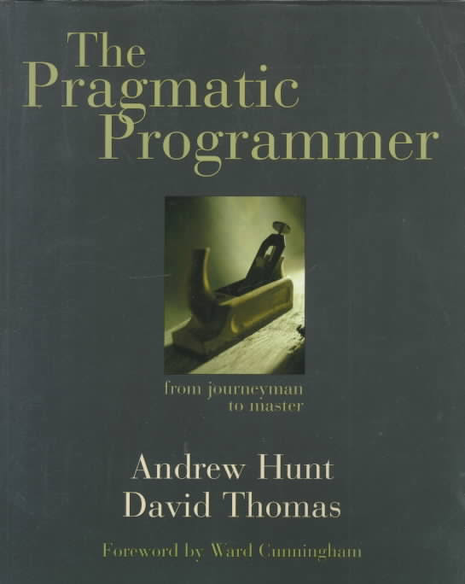
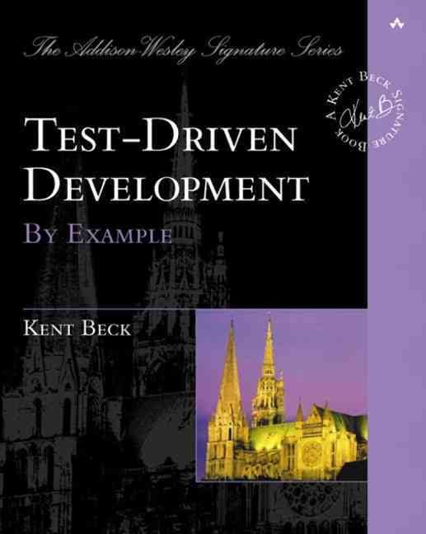
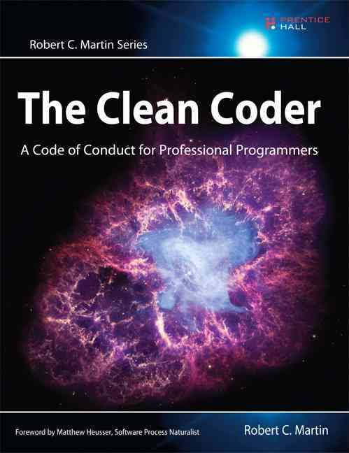
Recommended readings

Slide 53
The End
Thank you!

